Slide 1
Georgia Tech's Computational Photography Class
Portfolio
Irfan Essa (use your name)
prof.irfanessa.com / irfan@cc.gatech.edu
(use your contact info)
(TEMPLATE: Modify as needed!)
https://cs6475.wordpress.com/2015-fall/

Slide 2
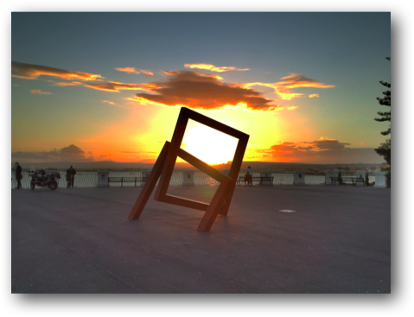
Assignment #1: A Photograph is a Photograph
Ortega, Sicily, Italy
Using an IPhone 4S

Slide 3
Assignment #2: Image I/O
Show whatever is appropriate

Slide 4
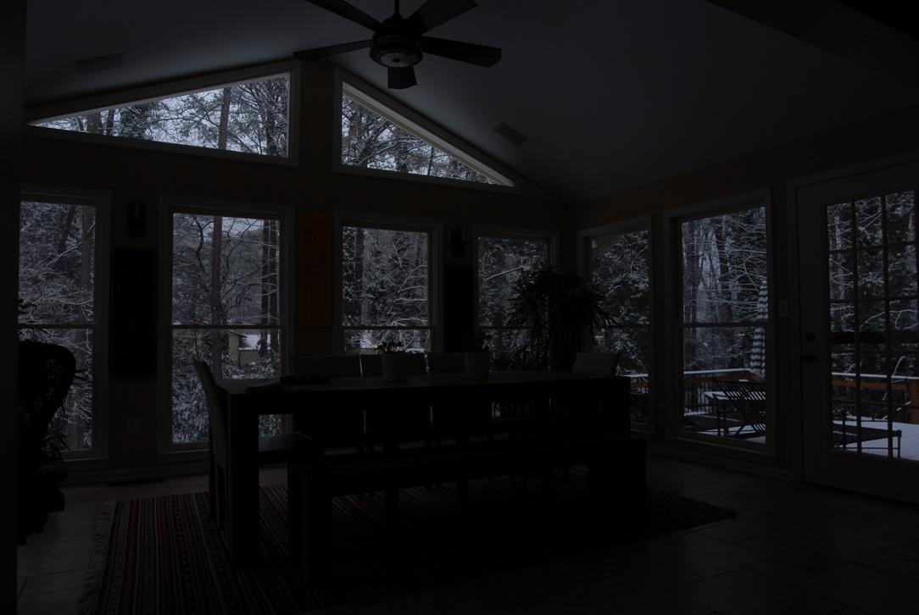
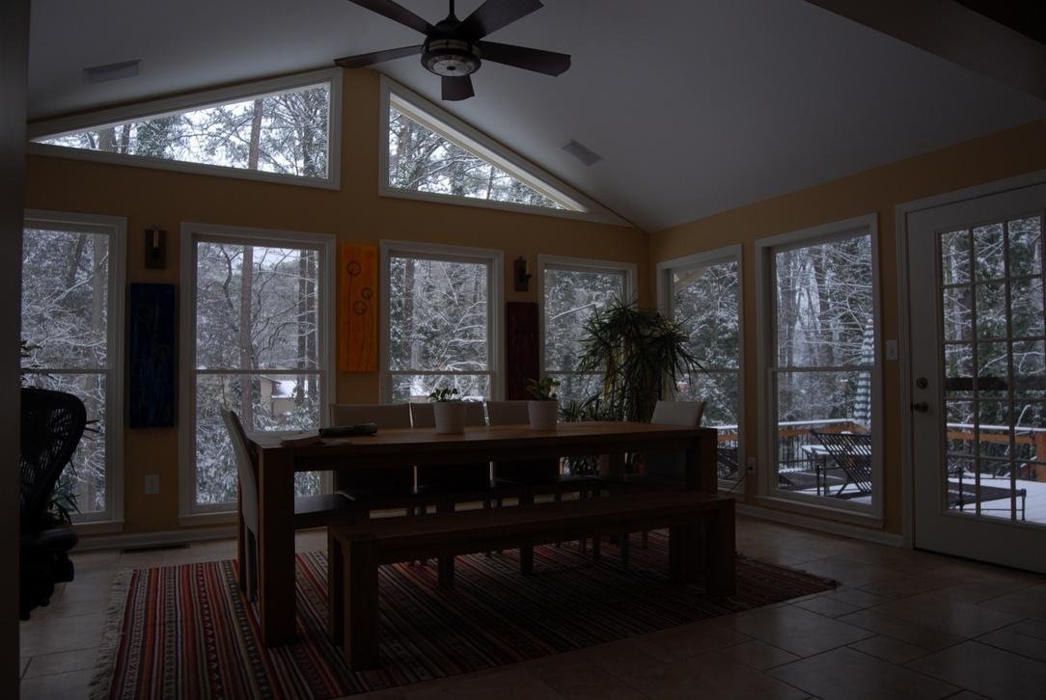
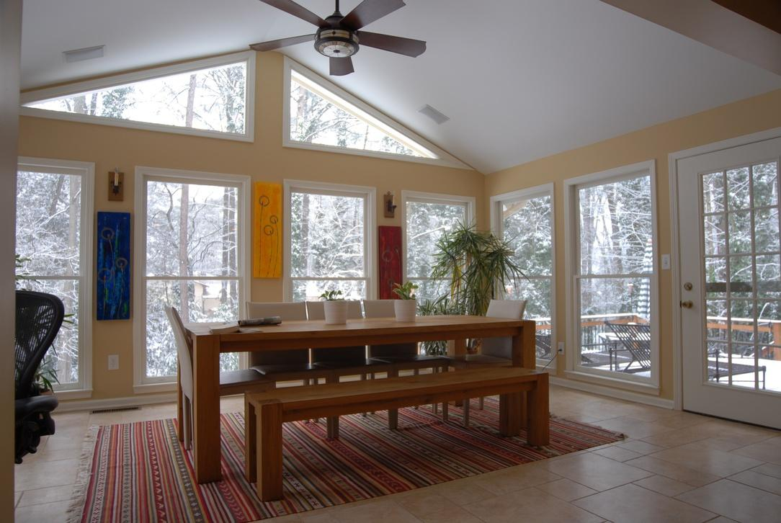
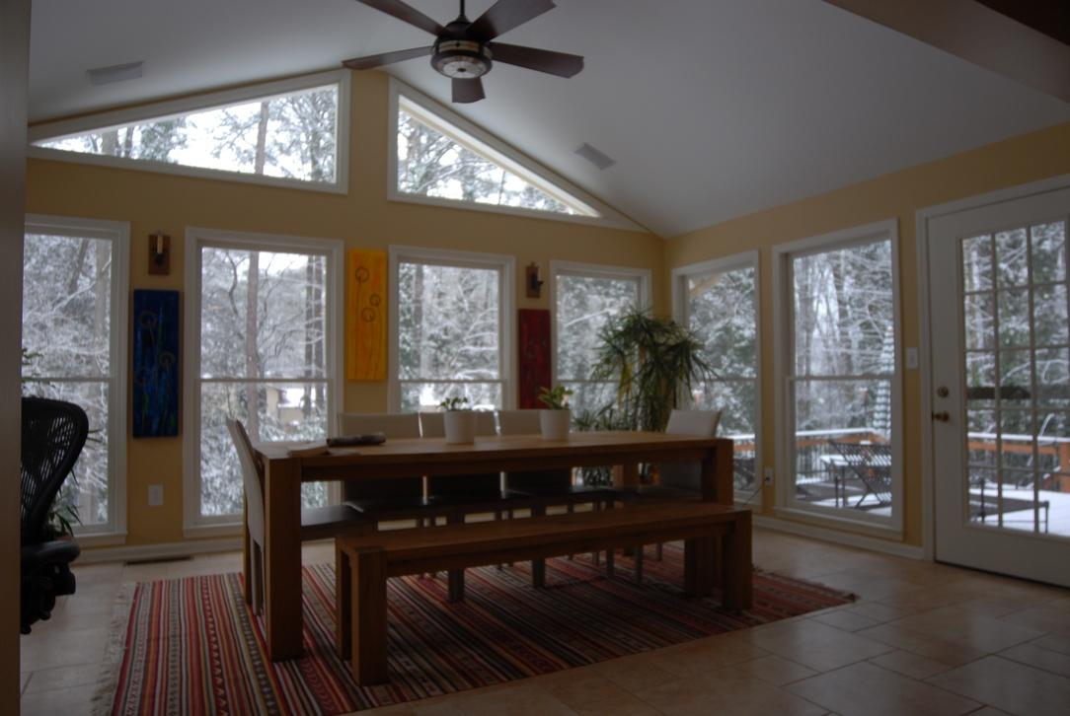
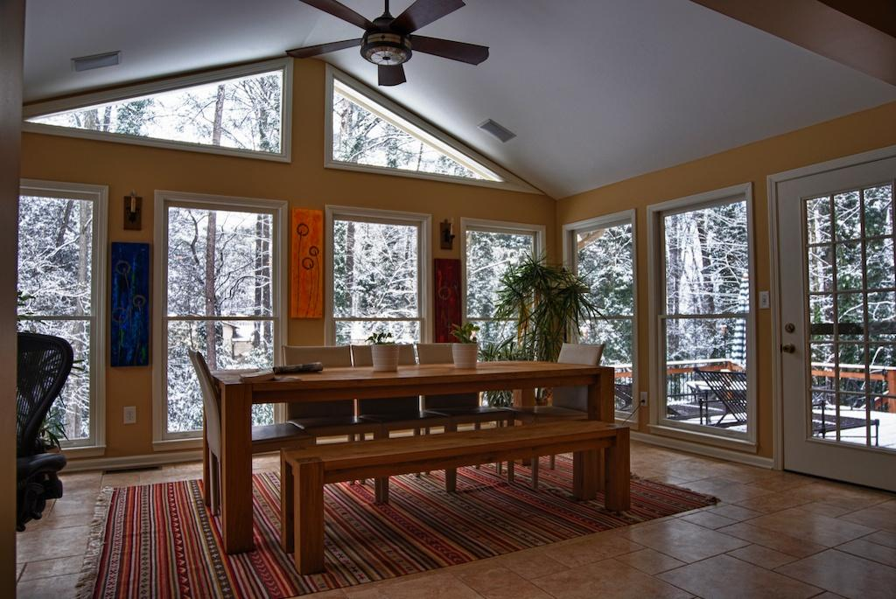
Assignment #3: Epsilon Photography
1
2
3
4
HDR
HOME: HDR of 4 different exposure images.

Slide 5
Assignment #4: Gradients and Edges
Show whatever is appropriate

Slide 6
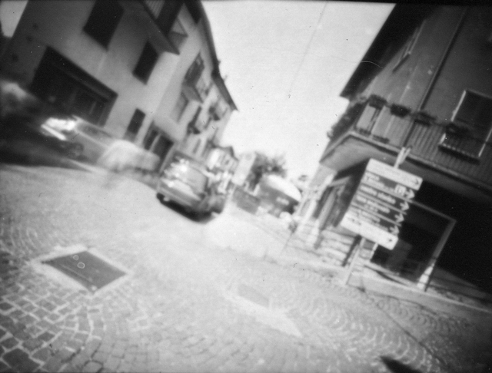
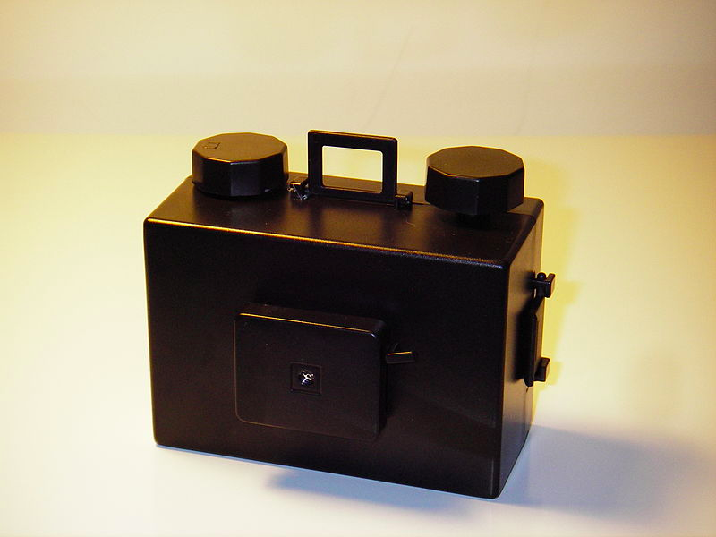
Assignment #5: Camera Obscura
Resulting Image
Setup
Feel free to add other images

Slide 7
Assignment #6: Blending
Show the Original Images and the Final BLENDED IMAGE

Slide 8
Assignment #7: Feature Detection
Share whatever you think is appropriate

Slide 9
Assignment #8: Panoramas
Share whatever you think is appropriate

Slide 10
Assignment #9: HDR
Show the Results from HDR Assignment

Slide 11
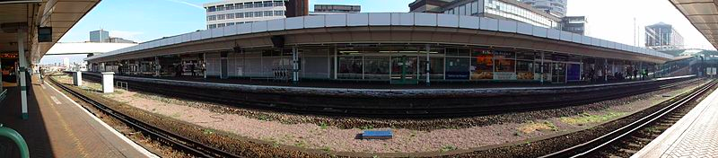
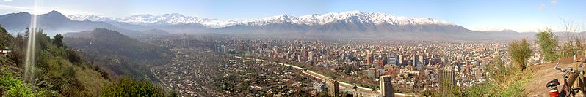
Assignment #10: Pictures of Space (1)
Panorama 1, # of Pictures. Software USED
Panorama 2, # of Pictures. Software USED

Slide 12
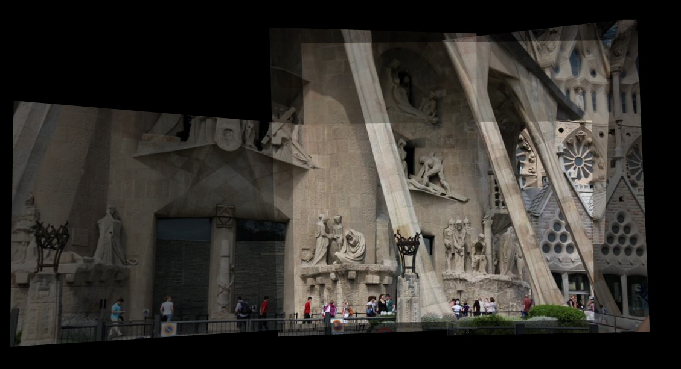
Assignment #10: Pictures of Space (2)
La Sagrada Famillia, http://photosynth.net/view.aspx?cid=9dfb7eb7-a389-4096-93fa-aa19140966cd
Synthy100%
Photos39

Slide 13
Assignment #11: Video Textures
Show the Results from Video Texture Assignment
Feel free to add links to other sites

Slide 14
Final Project
Details about the project, the goals and the team. Use figures as appropriate.

Slide 15
Final Project (2)
Show Before and After Images.

Slide 16
Anything else
Feel free to add.
For each assignment, you can also add extra pages!

